Slide 1
Return to Learn Fall 2021
Norfolk Public Schools
School Board Meeting
August 18, 2021

Slide 2
Return to Learn Fall 2021
Contents
5 Days A Week In Person Learning for ALL
A Safe and Healthy Return
Social Emotional Learning for Students and Staff
Transportation and Child Nutrition Services
Questions and Discussion
Academics
Virtual Scholars Academy
Staffing

Slide 3
2021 – 2022 In-Person Learning
Grade Levels | Grades PK - 12
Instruction | Five days a week with a minimum of 990 hours of in-person learning pending there are no reasons to close a school or classroom due to health concerns.
Scheduling | All students will be scheduled for in-person learning unless parents have chosen virtual learning.
Additional Information | Recent action by the General Assembly requires a full calendar of in-person instruction for the 2021-22 school year.

Slide 4
Temporary Staggered Start Times
 | Pre-Pandemic | Temporary Changes As of March 2021
First Stagger | 7:25 a.m. – 2:05 p.m. | 7:25 a.m. – 2:05 p.m.
Second Stagger | 8:15 a.m. – 2:45 p.m. | 8:30 a.m. – 3:00 p.m.
Third Stagger | 8:55 a.m. – 3:20 p.m. | 9:15 a.m. – 3:40 p.m.
Fourth Stagger | 9:30 a.m. – 3:55 p.m. | 9:55 a.m. – 4:20 p.m.

Slide 5
Instructional Focus
Pacing and curriculum revisions
Assessment and data gathering
"Just-in-time" assessments
Collaboration with teachers to develop aligned unit assessments for more frequent data collection and feedback
Use of software to provide individualized support for students in literacy and math
Added tutors and tutoring funds
PALS K-2 Tutors
Middle School Reading/Math tutors for support classes
The Literacy Lab Tutors (9 schools)
High School Tutoring Funds
Funds Dedicated for Students with Disabilities

Slide 6
Professional Learning
Literacy Retreat (Building Admin/Reading Specialists)
Literacy Boot Camp (Teachers)
1st Grade Integrated Curriculum
Social Emotional Learning
Culturally Responsive Teaching
Unfinished Teaching and Learning
Performance Based Assessments

Slide 7
Leadership Institutes and Data Meetings
Division level calendar of school data meetings to support schools in meeting goals for reading and math literacy
Professional development for building level administrators in Leadership Institutes

Slide 8
Culture of Caring: Support NPS Staff
Professional Development
Self-Care Activities
Staff Collaboration
Mentoring
Employee Assistance Program

Slide 9
2021 – 2022 In-Person Learning
Health and Safety of our students and staff.
Core Mitigation Strategies
Face Masks, Social Distancing, Hand Washing/Sanitizing, Cleaning/Sanitizing and Contact Tracing
CDC Guidelines
Follow up-to-date CDC guidelines throughout the reopening process.
Local Health Department
Continued collaboration with the Norfolk Department of Public Health.
Secondary Mitigation Strategies
Percent of New Cases, Percent of Occupied Hospital Beds, Percent of COVID-19 Hospital Patients and Number of Outbreaks.
Successful Fall School Reopening!

Slide 10
Vaccinations
Employee Vaccination Events
High School Vaccination Clinics
Middle School Vaccination clinics
Athletics Vaccination Clinics
Vaccination clinics are open daily for anyone 12 and older at Military Circle Mall. Minors must be accompanied by a parent/guardian.
Continued collaboration for vaccinations at school sites

Slide 11
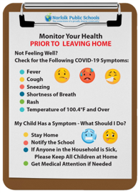
Daily Updates and Prescreening
Daily updates​ on dashboard
New cases per 100,000 people
Percent positive tests per 100,000 people
School Covid cases
Prescreening tool on each school's website​
Mitigation strategies and guidelines for a safe return

Slide 12
New Covid Cases Over Time

Slide 13
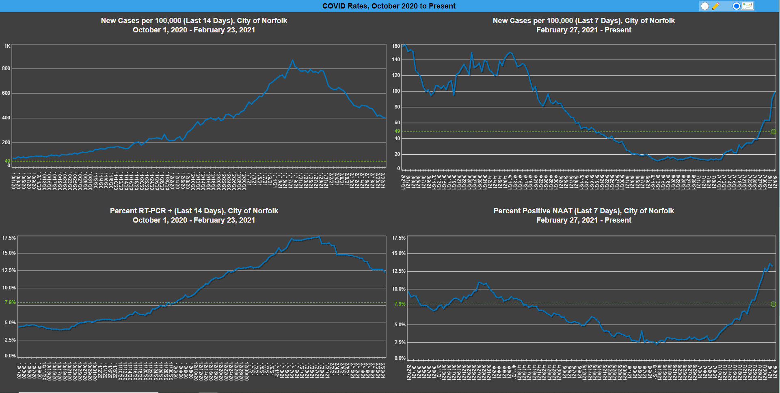
Percent Positive Over Time

Slide 14
Quarantining for Staff
Employees may be quarantined by an NPS contact tracer, private healthcare professional, or other approved entity (i.e. Department of Health).
NPS School Board Policy GCBDZ - Employee Leave.
Exposure Inside the Workplace: NPS will provide paid leave for the duration of the quarantine period.
Exposure Outside the Workplace: Employees must use accrued leave to receive compensation for any days missed as a result of quarantine.
Telework/work-from-home is not an allowable pay option for quarantine leave.
Other telework/work-from-home requests will be managed via existing Americans with Disabilities Act accommodation procedures.

Slide 15
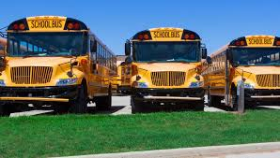
Transportation
Busses may operate at full capacity.
Mask wearing will be required while riding the school bus.
Windows will be opened to provide fresh air.
Busses will be sanitized after each route.
Here Comes the Bus!

Slide 16
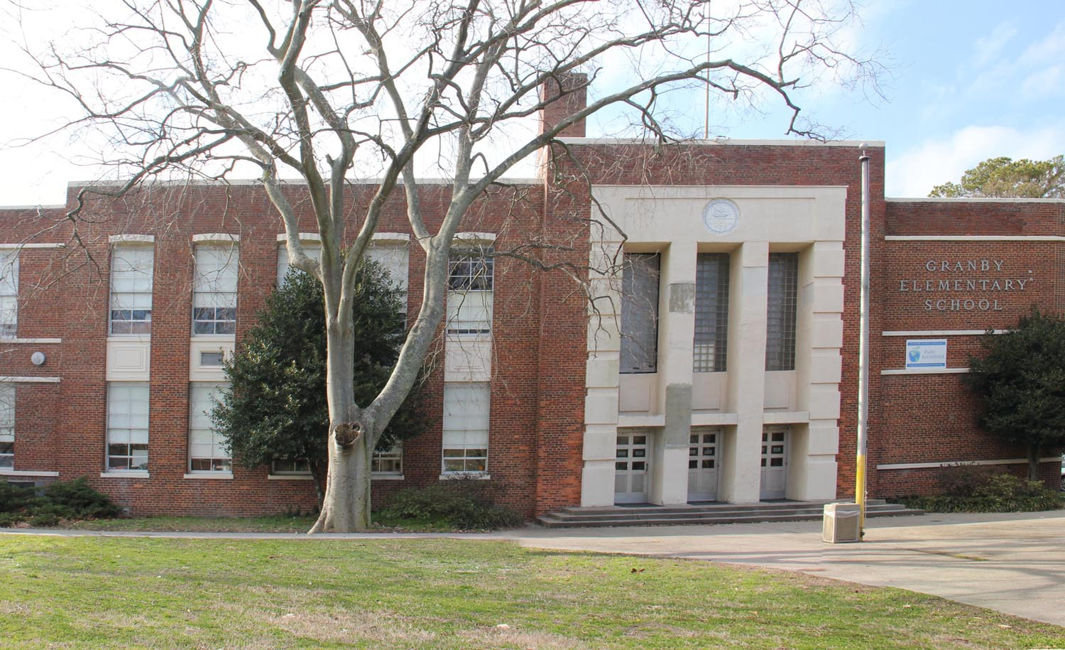
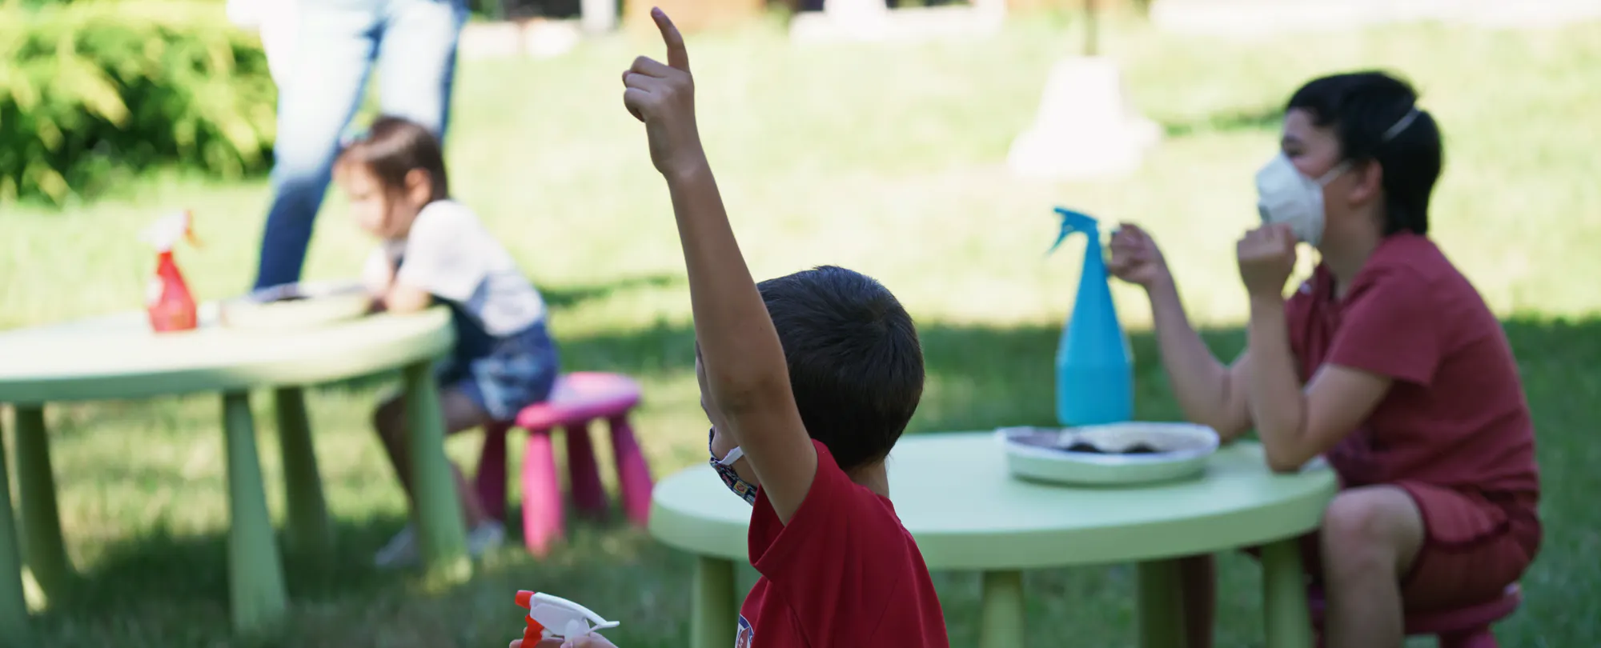
Ventilation, Cleaning, and Disinfecting
Open classroom windows
Heating, ventilation, and air Conditioning (HVAC)
Air filters maintenance
Open windows in transportation vehicles
Air scrubbers in gymnasiums and cafeterias
Continued protocols for cleaning and sanitizing schools

Slide 17
Food Service and School Meals

Slide 18
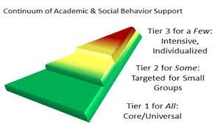
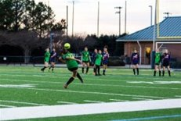
SEL Supports for Students
Counseling Supports
Positive Behavior Interventions and Supports
After School Activities
Athletics
Wellness Champions

Slide 19
Athletics
Middle School
High School
Fall​​ | Winter 1​​ | Winter 2​​ | Spring 1​ | Spring 2​
Football​ | Volleyball (Girls)​ | Basketball (Girls)​ | Field Hockey​ | Co-Ed Tennis​
Softball​ | Volleyball (Boys) ​ | Basketball (Boys) ​ | Baseball ​ | ​
Sideline/ Competitive Cheerleading​ | Wrestling ​ | Forensics ​ | Track (Girls) ​ | ​
Soccer (Girls)​ | Scholastic Bowl ​ | Sideline/ Competitive Cheerleading​ | Track (Boys)​ | ​
​ | ​ | ​ | Soccer (Boys)​ | ​
Fall | Winter | Spring
Cheerleading | Basketball | Baseball
Cross Country | Indoor Track | Soccer
Field Hockey | Swim/Dive | Softball
Football | Wrestling | Tennis
Golf | Forensics | Track and Field
Volleyball
Scholastic Bowl
One Act Play

Slide 20
Getting Reading for the Coming School Year

Slide 21
Virtual Scholars Academy
Grade Levels | Grades 4 - 12
Instruction | Students will have the option of synchronous, asynchronous or a blended model of instruction. These options are pending enrollment within each grade or class for virtual instruction.
Scheduling | Parents/Guardians and students must apply for this option.
Additional Information | Flexibility will be allowed for students to opt in or out of in-person learning during the school year. Some courses and grades will be partnered with Virtual Virginia offerings based on the number of student requests.

Slide 22
Virtual Scholars Academy 21-22 Updates
The Virtual Scholars Academy sign-up deadline was June 14th
School Level:
Elementary School – Grades 4 & 5:
93 students
Middle School – Grades 6 – 8:
156 students
High School – Grades 9 – 12:
166 students
Total Students:
417 students

Slide 23
Virtual Scholars Academy 21-22 Updates
Demographics:
Black:
276 - 66% of total VSA
White:
72 – 17% of total VSA
Hispanic:
29 – 7% of total VSA
2 or more:
25 – 6% of total VSA
Asian:
10 – 2% of total VSA

Slide 24
Virtual Scholars Academy 21-22 Updates
Demographics:
Students with a 504:
16
Students with a disability:
90
English Learner Students:
11
Gifted Students:
64

Slide 25
Virtual Virginia 21-22 Updates
If fewer than 8 students requested a course
OR
If the course was critical for the student to take and the course could not fit into the schedule (sequential electives, completers, etc.)
84 students are taking at least 1 Virtual Virginia course
7 in 8th Grade
5 in 9th Grade
15 in 10th Grade
26 in 11th Grade
22 in 12th Grade
If parents provided a medical need for a K-3 student to be virtual
17 K-3 students
4 in 1st Grade
4 in 2nd Grade
9 in 3rd Grade

Slide 26
Technology
All classroom teachers will receive new laptops starting this school year
Every student will have a school issued mobile device (Chromebook, iPad…)
MiFi's will be available for any student who needs Internet access anywhere
Implementing year one of a 3-year plan for all classrooms to have interactive flat panel displays
Real-time Chromebook monitoring
Increased level of cybersecurity with critical services moved to the cloud
Online Synergy registration
Virtual tech support

Slide 27
Return to Learn Fall 2021
Questions and Discussion
Norfolk Public Schools’
School Board Meeting
August 18, 2021

